Slide 1

ADO.Net
Basics
Tom Affholter, 2008

Slide 2

Objectives
A basic understanding of the concepts and object model of ADO.NET including:
  A DNA Model overview
  Connection object
  Command Objects
  Data Providers
  DataReaders
  ExecuteReader
  ExecuteNonQuery
  Unbound data
  Bound Data
  DataAdapters
  Datasets

Slide 3
ADO.NET - The Big Picture
Today’s computer/web applications tend typically to be data driven.
Among the most important skills, if not the most important skill, is the ability to automate your application to read and/or write to a database or other external data source.
Database connectivity drives e-commerce.

Slide 4
Considerations for Tying and Application to a Data Source
Where is the data?
What format is the data in?
How do you connect to the data?
How do you communicate with the source of the data?
How is data requests passed to and received from the data source?
How is concurrency handled?
How are form items tied to data?

Slide 5

What is ADO.NET?
ADO.NET, a Microsoft Technology, stands for ActiveX Data Objects for .NET
ADO.NET is a collections of tools (classes) we can use to query and manipulate both local and remote data.

Slide 6
DNA Reference Model 1
Presentation
Business
Logic
Data

Slide 7



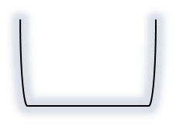


DNA Reference Model 2
Presentation
Business
Logic
Data

Slide 8

DNA Reference Model 3
Presentation
Business
Logic
Data

Slide 9
DNA Reference Model
Using ASP.net & ADO.net
ADO.net
XHTML
CSS
JavaScript
ASP.net (C#)
JavaScript
SQL Server
Also known as
“DataSource”
or
“Data Provider”

Slide 10
Why ADO.Net?
Simplifies connectivity
Maintains a “disconnected” database model.
Maintains Concurrency
Offers connectivity from the novice to the expert.
Data is transferred from the server to the client using XML standards that can be manipulated.
Notes:
To cope up with some of the problems with data connectivity, ADO .NET came into existence. Most types of data connectivity (such as ASP 3.0) maintained a constant connection to the data.
ASP 3.0 was an interpreted language that was embedded in your HTML page. It therefore ran slower.
ADO .NET addresses the connection problems by maintaining a disconnected database access model which means, when an application interacts with the database, the connection is opened to serve the request of the application and is closed as soon as the request is completed. Likewise, if a database is Updated, the connection is opened long enough to complete the Update operation and is closed. By keeping connections open for only a minimum period of time, ADO .NET conserves system resources and provides maximum security for databases and also has less impact on system performance. Also, ADO .NET when interacting with the database uses XML and converts all the data into XML format for database related operations making them more efficient.

Slide 11
The “Data Provider”
The Data Provider is responsible for providing and maintaining the connection to the database.
A Data Provider is a set of related components that work together to provide data in an efficient and performance driven manner.
The .NET Framework currently comes with two Data Providers:
  the SQL Data Provider which is designed only to work with SQL Server 7.0 or later
  the OleDb Data Provider which allows us to connect to other types of DBMSs like Access and Oracle.

Slide 12
DataProviders
Namespaces | Descriptions
System.Data | Holds the DataSet and DataTable classes
System.Data.OleDb | Holds the class collection used to access an OLEDB data source
System.Data.SqlClient | Holds the classes used to access an SQL Server 7.0 data source or later
System.Data.Odbc | Holds the class collection used to access an ODBC data source
System.Data.OracleClient | Holds the classes used to access an Oracle data source

Slide 13
The “Data Provider” - cont
Each DataProvider consists of the following component classes:
  The Connection object which provides a connection to the database
  The Command object which is used to execute a command
  The DataReader object which provides a forward-only, read only, connected Dataset
  The DataAdapter object which populates a disconnected Dataset with data and performs queries, updates and inserts.
Notes:
The Connection Object
The Connection object creates the connection to the database. Microsoft Visual Studio .NET provides two types of Connection classes: the SqlConnection object, which is designed specifically to connect to Microsoft SQL Server 7.0 or later, and the OleDbConnection object, which can provide connections to a wide range of database types like Microsoft Access and Oracle. The Connection object contains all of the information required to open a connection to the database.
The Command Object
The Command object is represented by two corresponding classes: SqlCommand and OleDbCommand. Command objects are used to execute commands to a database across a data connection. The Command objects can be used to execute stored procedures on the database, SQL commands, or return complete tables directly. Command objects provide three methods that are used to execute commands on the database:
ExecuteNonQuery: Executes commands that have no return values such as INSERT, UPDATE or DELETE
ExecuteScalar: Returns a single value from a database query
ExecuteReader: Returns a result set by way of a DataReader object
The DataReader Object
The DataReader object provides a forward-only, read-only, connected stream recordset from a database. Unlike other components of the Data Provider, DataReader objects cannot be directly instantiated. Rather, the DataReader is returned as the result of the Command object's ExecuteReader method. The SqlCommand.ExecuteReader method returns a SqlDataReader object, and the OleDbCommand.ExecuteReader method returns an OleDbDataReader object. The DataReader can provide rows of data directly to application logic when you do not need to keep the data cached in memory. Because only one row is in memory at a time, the DataReader provides the lowest overhead in terms of system performance but requires the exclusive use of an open Connection object for the lifetime of the DataReader.
The DataAdapter Object
The DataAdapter is the class at the core of ADO .NET's disconnected data access. It is essentially the middleman facilitating all communication between the database and a DataSet. The DataAdapter is used either to fill a DataTable or DataSet with data from the database with it's Fill method. After the memory-resident data has been manipulated, the DataAdapter can commit the changes to the database by calling the Update method. The DataAdapter provides four properties that represent database commands:
SelectCommand
InsertCommand
DeleteCommand
UpdateCommand
When the Update method is called, changes in the DataSet are copied back to the database and the appropriate InsertCommand, DeleteCommand, or UpdateCommand is executed.

Slide 14
ADO.NET ARCHITECTURE
System.Data
DataSet
DataTable
DataReader
CommandBuilder
DataRow
Update
DataColumn
Command
DataAdapter
Constraint
Fill
Connection
DataRalation
Database
XML File

Slide 15
The Connection Object
The connection object identifies:
  The type of connection (SQL Server or other)
  Startup database
  Login and Password (if applicable)
SqlConnection conn;
conn= new SqlConnection("Data Source=DatabaseServer; Initial Catalog=Northwind; User ID=YourUserID;Password=YourPassword");
or
SqlConnection conn = new SqlConnection("Data Source=DatabaseServer; Initial Catalog=Northwind; User ID=YourUserID;Password=YourPassword");
  Data Source can be either a path (Access), a computer name (internal) or an IP (internal or external)
  Note: All programming examples is this class will be in C# and will be completed using a Windows Application.

Slide 16
Using the Connection Object
The purpose of creating a Connection object is so you can enable other ADO.NET code to work with a data base. Other ADO.NET objects we will look at, such as a Command and DataAdapter objects, take a connection object as a parameter. The sequence of operations occurring in the lifetime of a Connection are as follows:
  Instantiate the Connection.
  Open the connection.
  Make the connection available to other ADO.NET objects.
  Close the connection.

Slide 17
Using the Connection Object
-cont-
Example:
  Create & Open (shortcut)
    SqlConnection conn = new SqlConnection(“Data Source =(local); Initial Catalog=Northwind;");
    conn.Open();
  Close
    conn.Close();

Slide 18
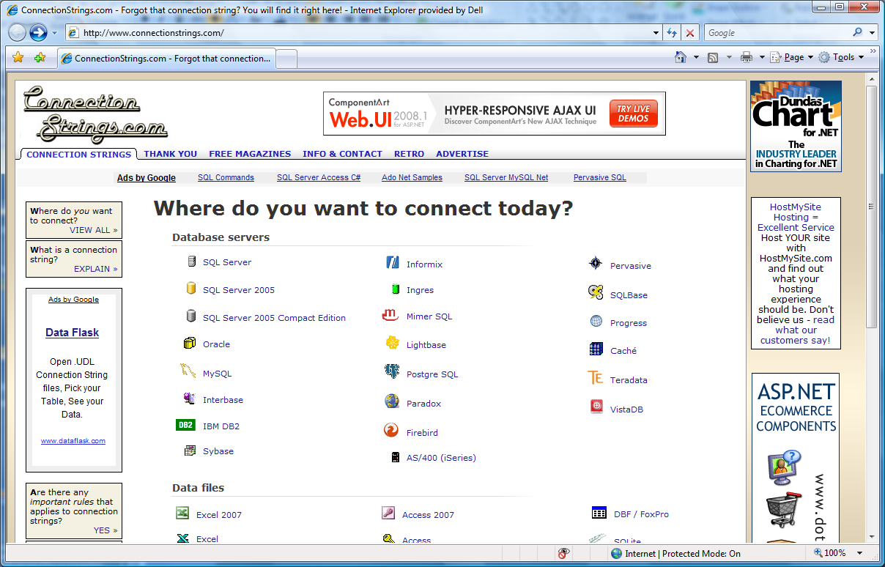
Building a
Connection String - 1
Internet Research

Slide 19
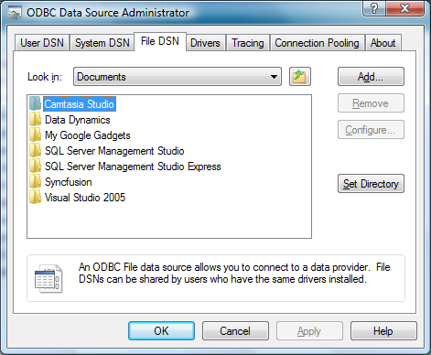
Building a
Connection String - 2
Windows: Control Panel \Administrative Tools\Data Sources (ODBC)

Slide 20
The Command Object
You need to be able to pass a SQL Statement to the DBMS engine. This is performed with a Command Object.
The Command object works with Connection object to find the data source.
SqlCommand cmd;
cmd= new SqlCommand( "select * from Customers",conn);
Or
SqlCommand cmd = new SqlCommand( "select * from Customers",conn);

Slide 21
The Command Object
-cont-
The Command object also allows for parameters (arguments) to be passed to the command object.
    SqlParameter param = new SqlParameter();
    param.ParameterName = "@City";
    param.Value = inputCity;
    SqlCommand cmd = new SqlCommand("select * from Customers where city = @City", conn);
    cmd.Parameters.Add(param);
  Note: You can also build the SQL statement through concatenation without parameters although the above method is suggested.
    SqlCommand cmd = new SqlCommand("select * from Customers where city = ‘“ + txtSearch.text + “’”, conn);

Slide 22
Value Returning SQL Commands
Some SQL Statements return values (or datasets) such as:
  Select statements or stored procedures
Other statements perform an operation but return no values
  Insert, Update or Delete statements
These types of commands are addressed differently in ADO.NET

Slide 23
Types of Commands
Three ways to execute a Command (depending on what, if anything, is expected to be returned).:
  ExecuteReader
    Send the CommandText to the Connection and build a DataReader. Data is read-only and can be accessed with a forward read (can’t read backwards).
  ExecuteNonQuery
    Execute a SQL statement against the Connection and typically return the number of rows affected but no dataset.
  Fill() Method of a DataAdapter
    Uses a DataAdapter to manage disconnected data. Returns a dataset that can be used for select, insert, update and delete statements.

Slide 24

Two Methods for Manipulating Data from an Application
Bound
  Involves marrying a control to a field in a DataSet/DataReader. When data changes in a control, it is updated (by command) to the underlying/linked table.
  Easy; fast development, can use a Wizard; more difficult to debug; not particularly flexible.
Un-Bound
  Controls are not tied to the field or table. Rather, the programmer programmatically develops SELECT, INSERT, UPDATE and DELETE statement by concatenating strings together.
  Much more time consuming to develop; much more versatile with respect to development flexibility.
Notes:
Demo Both Here

Slide 25
DataReader vs. DataSet
When data are returned there are generally two uses:
  Read only (DataReader)
    Reports, populating a web page of available parts, populating a combo box, etc.
  Read/Write (DataSet)
    User needs ability to edit, delete and insert information.

Slide 26
The DataReader
Read-only
  Common if you are only presenting output
  Returned from a SELECT or StoredProcedure
// 1. Instantiate a new command with a query and connection
SqlCommand cmd = new SqlCommand("select CategoryName from Categories", conn);
// 2. Call Execute reader to get query results
SqlDataReader rdr = cmd.ExecuteReader();
The returned data is in DataReader rdr.

Slide 27

The DataReader
-cont-
The DataReader can be assigned directly to a read-only grid:
    this.DataGrid1.DataSource = rdrMyData;
Or you can assign the contents to a textbox.
  this.txtCustomerName.Text = rdrRepairOrder.GetString(3);
  Or
    this.txtCustomerName.Text = rdrRepairOrder.GetString(“CustName”);
Or you can thumb thru the records
  while (rdr.Read())
  {
  Console.WriteLine(rdr[“fieldname”);
  }
Datagrid Example

Slide 28
ExecuteNonQuery
This command is used to send a non-returning statement to the DB engine such as:
  INSERTs
  UPDATEs
  INSERTs
Commonly used with non-bound ADO.net techniques.
If the data can be modified by multiple clients, concurrency might be an issue.

Slide 29
ExecuteNonQuery
-cont-
String cnStr = "Data Source=134.39.173.35;Initial Catalog=DEMOGUEST;User ID=DEMOGUEST;Password=demo";
String strSQL;
//Connection string.
SqlConnection cn = new SqlConnection();
//Assign Connection string to the connection object
cn.ConnectionString = cnStr;
//Open the connetion to the SQL Server
cn.Open();
//This concatenates the insert statement. Of course you would add loads of error checking
strSQL = "insert into tblZipcodes values ('" + txtZip.Text + "','" + txtCity.Text + "','" + txtState.Text + "')";
//This statement creates the command object and passes in the SQL statement
//then associates the command to the cn connection object
SqlCommand cmd = new SqlCommand(strSQL,cn);
//Execite command. Returns no rows.
cmd.ExecuteNonQueryr();
//Close connection
cn.Close();

Slide 30
Data Drive Sites using DataReaders and ExecuteNonQuery()
You can develop complete unbound Windows and web driven websites using:
  DataReaders()
    Retrieve data to select from (combobox or grid) or to edit from an ExecuteNonReader()
  ExecuteNonReader()
    Insert update or delete data

Slide 31
Stepping Back – The DataAdapter
Managing data involves the ability to select, insert, update and delete data.
A DataAdapter is an container object that brings all the ADO.NET components together including: connections, commands, select, insert, update and delete statements.
As we will discuss in a moment, we can let C# build the DataAdapter for us, or we can manually build it. If you use a wizard, the connection and command objects are created for you but you do lose some control for the sake of speed and convenience. DataAdapter code, generated by the wizard, is placed in Windows generated code and therefore should not be “tweaked”.
Those that choose to use a DataAdapter typically allow C# & ADO.net manage data. Some developers prefer more control and will use either no DataAdapters or a blend of techniques.

Slide 32
The DataAdapter
Architecture
System.Data
DataSet
DataTable
DataReader
CommandBuilder
DataRow
Update
DataColumn
Command
DataAdapter
Fill
Constraint
Connection
DataRalation
Database
XML File

Slide 33
The DataAdapter
The DataAdapter acts as the intermediary between the Connection and DataSet
The DataAdapter contains four command objects (Select, Insert, Update and Delete)
Each command object has a command text property that maintains the SQL statement.
Only the SelectCommand must be set. The others (insert, update and delete) will be generated for you.

Slide 34

Dataset
The dataset, formerly called a recordset, is a disconnected, in-memory representation of data.
The dataset be considered as a local copy of the relevant portions of the database. The dataset is persisted in memory and the data in it can be manipulated and updated independent of the database.
When the use of this Dataset is finished, changes can be made back to the central database for updating.
The data in Dataset can be loaded from any valid data source like Microsoft SQL Server, MySQL, Oracle, Access, and a variety of nontraditional data sources such as a flat file, Excel and more.

Slide 35

Building a
DataAdapter- 3
Visual Studio Wizard

Slide 36
DataAdapter
The DataAdapter has two important Methods:
  Fill()
    Loads Data from the data source into a DataSet
    Uses the CommandText of the Select Command
  Update()
    Transfers updated or inserted data from the DataSet back to the Data Source
    Calls the DataAdapter’s InsertCommand, UpdateCommand or DeleteCommand as appropriate

Slide 37
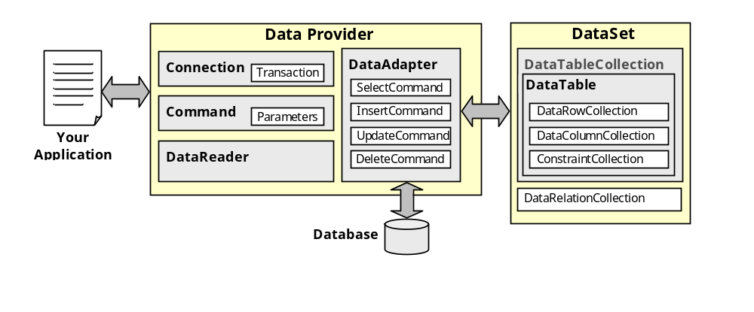
DataAdapter
Architecture

Slide 38
The DataAdapter
Sample Code by Hand
SqlConnection con = new SqlConnection ("data source=134.39.173.35;
uid= Maynard; pwd= BlackCrow; database=Northwind");
DataSet myDataSet = new DataSet ("Northwind");
SQLCommand myCommand = new SQLCommand ("Select * from employee");
SQLDataAdapter myDataAdapter = new SQLDataAdapter (myCommand, con);
myDataAdapter.Fill (myDataSet, "EmployeeData");

Slide 39
DataAdapter
Binding
Once the DataAdapter fills the DataSet, information can be referenced in a variety of ways:
  myDataGrid.DataSource = myDataSet;
Or
  txtLastName.DataBindings.Add("Text", myDataSet,“tblMembers.lastName" )

Slide 40
DataAdapter
Updating Changes
Once data editing is completed, you must issue an update to move the changes from the DataSet to the DataSource. This launches appropriate insert, update and delete statements.
myDataApapter.Update(myDataset)

Slide 41
ADO.NET Object Model Errors
Keep in mind all of the components in the object model have custom errors that can be managed in a try/catch.
  Such as:
    SQL Statement Error (Command Object)
    Database not found (Connection Object)

Slide 42
Summarizing ADO.NET
A connection object establishes the connection for the application with the database.
The command object provides direct execution of the command to the database. If the command returns more than a single value, the command object returns a DataReader to provide the data.
Alternatively, the DataAdapter can be used to fill the Dataset object.
The database can be updated using the command object or the DataAdapter.

Slide 43

Putting the Pieces Together

Slide 44
Two Methods for Manipulating Data from an Application
Bound
  Involves marrying a control to a field in a DataSet/DataReader. When data changes in a control, it is updated (by command) to the underlying/linked table.
  Easy; fast development, can use a Wizard; more difficult to debug; not particularly flexible.
Un-Bound
  Controls are not tied to the field or table. Rather, the programmer programmatically develops SELECT, INSERT, UPDATE and DELETE statement by concatenating strings together.
  Much more time consuming to develop; much more versatile with respect to development flexibility.
Notes:
Demo Both Here

Slide 45
Demo – The Wizard
First we will look at a demonstration where I create a Grid that is bound to a remote table using the Wizard.

Slide 46
Demo – Bound Data By Hand
In this demonstration, I will build a DataAdapter. After which, I will bind a textbox to the DataAdapter

Slide 47
Demo
In this last example, I will create a simple form and connect to the database using unbound techniques.

Slide 48
Managing Concurrency
Concurrency addresses a problem common with batch processing or, in our case disconnected data.
How do you address changes made by two users that access the same data and update the same record from disconnected data.
Whose data takes precedence?
How can you address this problem?
Notes:
ADO.NET is Microsoft’s new technology for working with data. One of the most trumpeted features of ADO.NET is the DataSet object, which is an object that stores data in an in-memory schema, complete with DataTable and DataRelation objects. The ability to store an entire schema in memory allows the DataSet to run completely disconnected; the DataSet has no knowledge of any underlying data source. The DataSet cannot connect to a database; instead, records are added programmatically and manipulated in the DataSet. You must then programmatically take the records from the DataSet and update the underlying data source.
Operating in a completely disconnected paradigm raises a particularly troublesome issue: handling concurrency violations. If, for instance, Bob fills a DataSet with records from a database and is making changes to them in a disconnected mode at the same time Kim is updating those records with another application, how do you determine that the records have changed when Bob tries to apply his changes to the database? Let's examine how ADO.NET handles checking for concurrency conflicts, and take a look at how to handle concurrency violations.

Slide 49
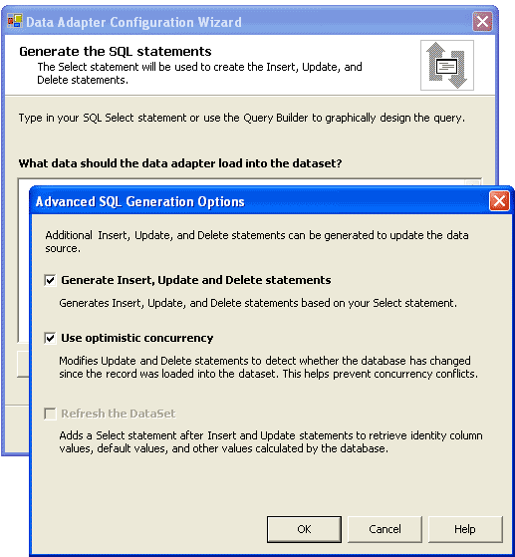
Concurrency Using the DataAdapter Wizard
Notes:
When you are in Visual Studio .NET, you can use the Data Adapter Configuration Wizard to generate all the Command objects in the DataAdapter. This makes life much easier, although you are also always free to generate the commands yourself.
What few developers have noticed is that, by default, the Data Adapter Configuration Wizard generates SQL statements that check for optimistic concurrency violations. The term optimistic concurrency means that you assume no one will be making edits to a record while you are making your edits. In other words, you don’t think two people will be editing the same record at the same time. Because you are optimistic that two people will not edit the same record simultaneously, you do not apply a lock to the record as soon as a user starts to edit it. Instead, you apply the lock only when the actual update is attempted. This results in a much shorter lock, and in database terms, the rule is simple: Locks are good, but long locks are bad.
You can see this behavior by starting a new project in VS.NET and dragging a SqlDataAdapter or OleDbDataAdapter onto a designer surface. If you step through the wizard and choose to use SQL statements, the next page of the wizard will allow you to type in the Select statement. This page has a button labeled Advanced Options. Clicking this button opens the Advanced SQL Generation Options dialog box, and by default, the option for using optimistic concurrency is turned on.

Slide 50
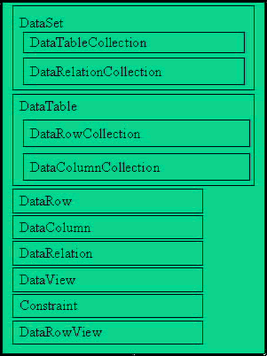
DataSet Class from a Concurrency Perspective
Notes:
To check for optimistic concurrency violations, the Data Adapter Configuration Wizard writes SQL statements that verify the record you are about to update or delete has not changed since you originally loaded it into your DataSet. The Wizard does this by adding a large WHERE clause to the SQL statement to verify that it is updating or deleting an exact match of what was downloaded and placed in the DataSet. You remember I told you that some feel the insert, update and delete statements were inefficient. That is not altogether true. This is Microsoft’s method for testing for data changes since you last filled your dataset. If you are updating a record with a field both you and other client update, you receive a concurrency violation error. You would normally catch that error in a try/catch to decide how to proceed.
However, this also relies on another aspect of the DataSet: The DataTable objects can store multiple versions of each row. If you could peer into a DataSet in memory, you would see one or more DataTable objects. Each DataTable would be made up of DataRow objects. Each record in the table, however, can actually exist multiple times, where each record has a different DataRowVersion. It is possible to insert, edit and delete a record before the underlying datasource is updated. But I should mention, it is uncommon if not unwise to keep a changed dataset in memory for long without updating the datasource. Most issue an update after every insert, update or delete command. If this methodology is followed, optimistic concurrency is the wisest since the only time of risk is minimal.
There are four possible values for the DataRowVersion, but the ones that will come into play with optimistic concurrency are Current and Original. When the DataAdapter first populates the DataSet with records, each DataRow is given a DataRowVersion of Original. If you then edit a record, the changes are stored in a new version of the record with a DataRowVersion of Current. Now, you have both the Original version (what was retrieved from the database) and the Current version (the changes you propose to make). It is called the Current version because it is the current version of the data in your DataSet; it is not yet the current version in the underlying database.
As an example, assume you have a table named Person in a database. You retrieve all the records from the Person table and place them in a DataSet. In the Person table is a field named LastName. On the first record, the LastName field is Smith when you retrieve the record. You change the LastName to Jones in the DataSet.
If you call the DataAdapter’s Update method, the query that is run will attempt to update the LastName field for the first record to Jones. However, it will first check to make sure that the current value for the first record in the database is Smith. How does it do this? I mentioned it briefly a moment ago – those seemingly inefficient automatically generated statements from Microsoft.

Slide 51
DataSet Wizard Generated Code
UPDATE Person SET LastName = @LastName,
WHERE (LastName = @Original_LastName) AND
Me.SqlUpdateCommand1.Connection = Me.SqlConnection1
Me.SqlUpdateCommand1.Parameters.Add(New _
System.Data.SqlClient.SqlParameter("@LastName", _
System.Data.SqlDbType.VarChar, 40, "LastName"))
Me.SqlUpdateCommand1.Parameters.Add(New _
System.Data.SqlClient.SqlParameter("@Original_LastName", _
System.Data.SqlDbType.VarChar, 40, _
System.Data.ParameterDirection.Input, False, _
CType(0, Byte), CType(0, Byte), "LastName", _
System.Data.DataRowVersion.Original, Nothing))
Notes:
If you look at the code generated by the Data Adapter Configuration Wizard, the Update statement contains a WHERE clause that examines the existing value of each field in the database to verify that they match the values that were originally downloaded. In other words, the query takes the values from the Original DataRowVersion of the record and makes sure those values are the ones still in the database. If they are, the values from the Current DataRowVersion are used to update the database. The code snippet on this slide shows the appropriate code for the LastName field.
The wizard creates parameters to hold the Current and Original versions of each field. You can see the Current version is held in a parameter named @LastName, and the value is pulled from the DataTable simply by calling the field name LastName. However, the parameter @Original_LastName is pulled from the DataTable by specifying that you need the LastName field where the DataRowVersion is Original. In the example above, the Update would attempt to set the LastName field to Jones where the LastName field is Smith.
In this simple example, I left out the primary key field, which you would normally have to ensure you are updating just one record.
In the previous example, you change Smith to Jones for a record. However, before you call the Update method, someone else could change the last name to Anderson. Now, when you call the Update method, the query will attempt to change the LastName field to Jones where the LastName field is Smith. However, no record now has a LastName of Smith, so ADO.NET knows that the record has been updated or deleted, and the update will fail.

Slide 52
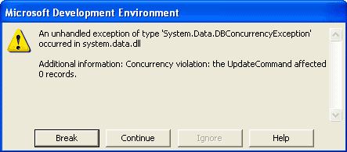
Optimistic Concurrency Violation
Notes:
While the wizard generates code to check for optimistic concurrency by default, it does nothing to handle a concurrency violation. In fact, if you change a record and call the Update method after someone else has changed that record, ADO.NET raises an unhandled exception. By default, you will receive the error shown on this slide.
Obviously, this error is less than useful. Instead, you’ll want to inform the user not just that optimistic concurrency has failed, but what the old and new values for the field happen to be. I wish I had more time in this lecture, but you will need to research ways of handling optimistic concurrency violations and show you how to present that information to the users.
Catching optimistic concurrency is simple if you use the Data Adapter Configuration Wizard. Even if you create the Update and Delete statements manually, you simply create the WHERE clause that verifies the values in the underlying database match the Original DataRowVersion values in your DataSet. To make sure you can check for optimistic concurrency violations, it's important that you understand the DataRowVersion property of the DataRow. However, handling these violations is not done for you automatically. This means you should go back and modify those insert, update and delete statements we built earlier if we want to address concurrency – and it is a rare occasion when you don’t.

Slide 53
Pessimistic Concurrency
When you select other than Optimistic concurrency, optimistic is chosen.
Optimistic assumes contention for data and will issue a record lock on all records you place in your dataset until such time as you release the dataset.
Users cannot load or update a locked record without receiving a contention error.

Slide 54


